Slide 1

Web and HTTP
Wuhan University of Technology
Master Computer Science
- Information Security -
Gouasmia Zakaria
Gouasmia.zakaria1@gmail.com
2018/2019

Slide 2
What is HTML ?
HTML: hypertext markup language
Definitions of tags that are added to Web documents to control their appearance

Slide 3
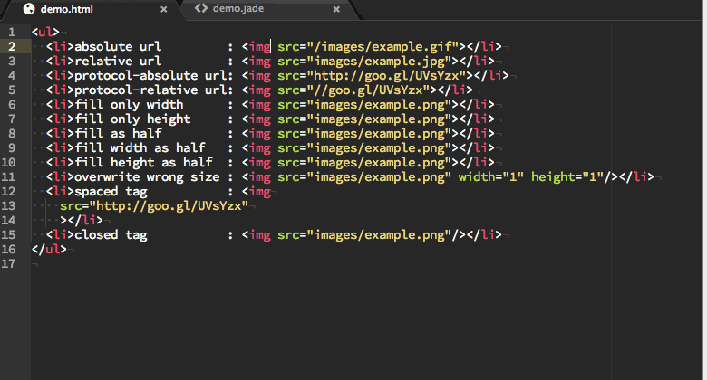

Slide 4

What is a website ?

Slide 5
Website is
a group of World Wide Web pages usually containing hyperlinks to each other and made available online by an individual, company, educational institution, government, or organization

Slide 6
The TCP/IP protocol layers
The application program is king – it gets work done using the lower level layers for communication between the client and server.
Application
Transport
Internet
Data link
Physical
Get useful work done – retrieve Web pages, copy files, send and receive email, etc.
Make client-server connections and optionally control transmission speed, check for errors, etc.
Route packets between networks
Route data packets within the local area network
Specify what medium connects two nodes, how binary ones and zeros are differentiated, etc,

Slide 7
What is URL ?
Is the address of a resource (such as a document or website) on the Internet that consists of a communications protocol followed by the name or address of a computer on the network and that often includes additional locating information (such as directory and file names)

Slide 8
URL

Slide 9
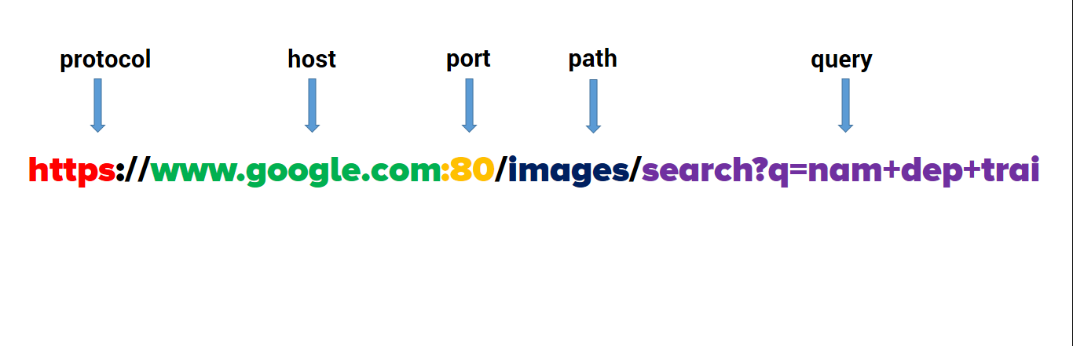
URL (Uniform Resource Locator)

Slide 10
WHAT IS A protocol ?
In diplomatic circles, a protocol is the set of rules governing a conversation between people
We have seen that the client and server carry on a machine-to-machine conversation
A network protocol is the set of rules governing a conversation between a client and a server
There are many protocols, HTTP is just one

Slide 11
An HTTP conversation
Client
Server
OK
Send page or error message
OK
I would like to open a connection
GET <file location>
Display response
Close connection
HTTP is the set of rules governing the format and content of the conversation between a Web client and server

Slide 12
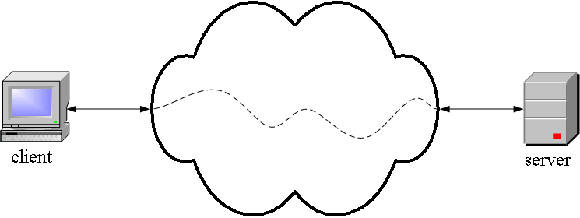
HTTP is an application layer protocol
The Web client and the Web server are application programs
Application layer programs do useful work like retrieving Web pages, sending and receiving email or transferring files
Lower layers take care of the communication details
The client and server send messages and data without knowing anything about the communication network

Slide 13
The application layer is boss – the top layer
Layer | Function
Application | Do useful work like Web browsing, email, and file transfer
Lower layers | Handle communication between the client and server
Your boss says: Send this package to Miami -- I don't care if you use Federal Express, UPS, or any other means. Also, let me know when it arrives or if it cannot be delivered for some reason.
The application program says: Send this request to the server -- I don't care how you do it or whether it goes over phone lines, radio, or anything else about the details. Just send the message, and let me know when it arrives or if it cannot be delivered for some reason.
There are five TCP/IP layers, the application layer and four lower layers.

Slide 14
Many application layer protocols are used on the Internet, HTTP is only one
Protocol | Application
HTTP: Hypertext Transfer | Retrieve and view Web pages
FTP: File Transfer | Copy files from client to server or from server to client
SMTP: Simple Mail Transport | Send email
POP: Post Office | Read email

Slide 15
Let’s talk more about HTTP

Slide 16
The Hypertext Transfer Protocol (HTTP) is an application protocol for distributed, collaborative, hypermedia information systems. HTTP is the foundation of data communication for the World Wide Web.

Slide 17
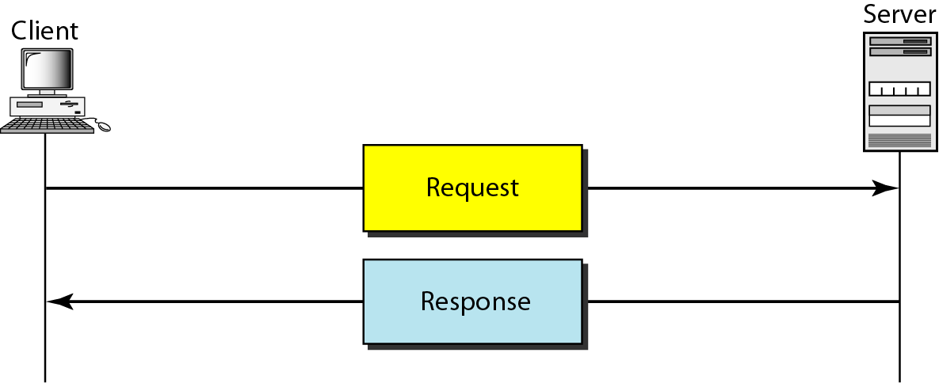
COMMUNICATION

Slide 18
HTTP IS
is connectionless protocol
Can deliver any sort of data
Is stateless

Slide 19
1. HTTP follows a classical "client-server" model 2. HTTP is a TCP/IP based communication protocol 3. The standard port for HTTP connections is port 80 4. The version of HTTP in common use is HTTP/1.1 HTTP/2 was published in May 2015

Slide 20

Resources

Slide 21
HTTP is used to transmit resources. A resource is some of information that can be identified by a URL (it's the R in URL). The most common kind of resource is a file, but a resource may also be a dynamically-generated query result, the output of a CGI script, a document that is available in several languages, or something else...

Slide 22
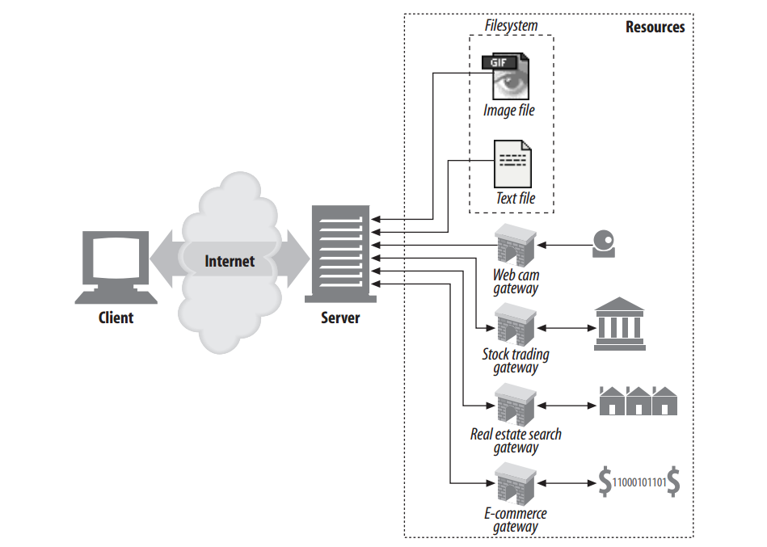

Slide 23
HTTP connections
non-persistent HTTP
at most one object sent over TCP connection
connection then closed
downloading multiple objects required multiple connections
persistent HTTP
multiple objects can be sent over single TCP connection between client, server

Slide 24
Non-persistent HTTP
suppose user enters URL:
(contains text,
references to 10
jpeg images)
www.someSchool.edu/someDepartment/home.index
1a. HTTP client initiates TCP connection to HTTP server (process) at www.someSchool.edu on port 80
1b. HTTP server at host www.someSchool.edu waiting for TCP connection at port 80. “accepts” connection, notifying client
2. HTTP client sends HTTP request message (containing URL) into TCP connection socket. Message indicates that client wants object someDepartment/home.index
3. HTTP server receives request message, forms response message containing requested object, and sends message into its socket
time

Slide 25
Non-persistent HTTP (cont.)
4. HTTP server closes TCP connection.
5. HTTP client receives response message containing html file, displays html. Parsing html file, finds 10 referenced jpeg objects
time
6. Steps 1-5 repeated for each of 10 jpeg objects

Slide 26

Non-persistent HTTP: response time
RTT (definition): time for a small packet to travel from client to server and back
HTTP response time:
one RTT to initiate TCP connection
one RTT for HTTP request and first few bytes of HTTP response to return
file transmission time
non-persistent HTTP response time =
2RTT+ file transmission time
initiate TCP
connection
RTT
request
file
RTT
time to
transmit
file
file
received
time
time

Slide 27
Persistent HTTP
non-persistent HTTP issues:
requires 2 RTTs per object
OS overhead for each TCP connection
browsers often open parallel TCP connections to fetch referenced objects
persistent HTTP:
server leaves connection open after sending response
subsequent HTTP messages between same client/server sent over open connection
client sends requests as soon as it encounters a referenced object
as little as one RTT for all the referenced objects

Slide 28
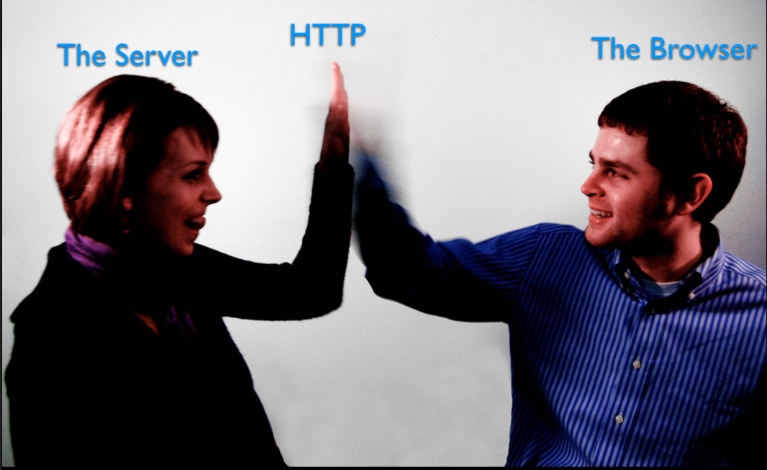
Transaction

Slide 29
Transaction

Slide 30
HTTP session consists of three phases: 1- The client establishes a TCP connection 2- The client sends its request and then waits for the answer. 3- The server processes the request and sends back its answer, containing a status code and the appropriate data. The connection is closed.

Slide 31
HTTP supports several different request commands, called HTTP methods. Every HTTP request message has a method. The method tells the server what action to perform.
Methods

Slide 32
Methods
Method | Description
GET | Retrieve information from the server.
HEAD | Same as GET, but transfers the status line and header section only.
POST | Send data to the server for processing.
PUT | Store the body of the request on the server.
DELETE | Remove a document from the server.
TRACE | Trace the message through proxy servers to the server.
OPTION | Determine what methods can operate on a server.
CONNECT | Converts the request connection to a transparent TCP/IP tunnel.
PATCH | Applies partial modifications to a resource

Slide 33
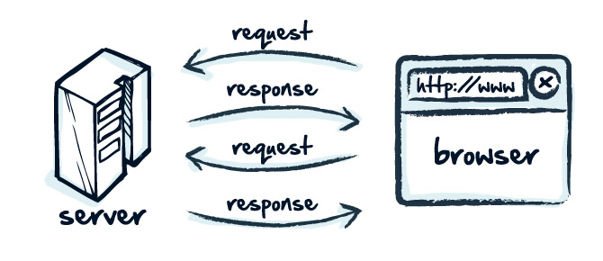
Messages ( request )

Slide 34
The message format consists of the following 3 items. Start-line Header Fields Message Body

Slide 35
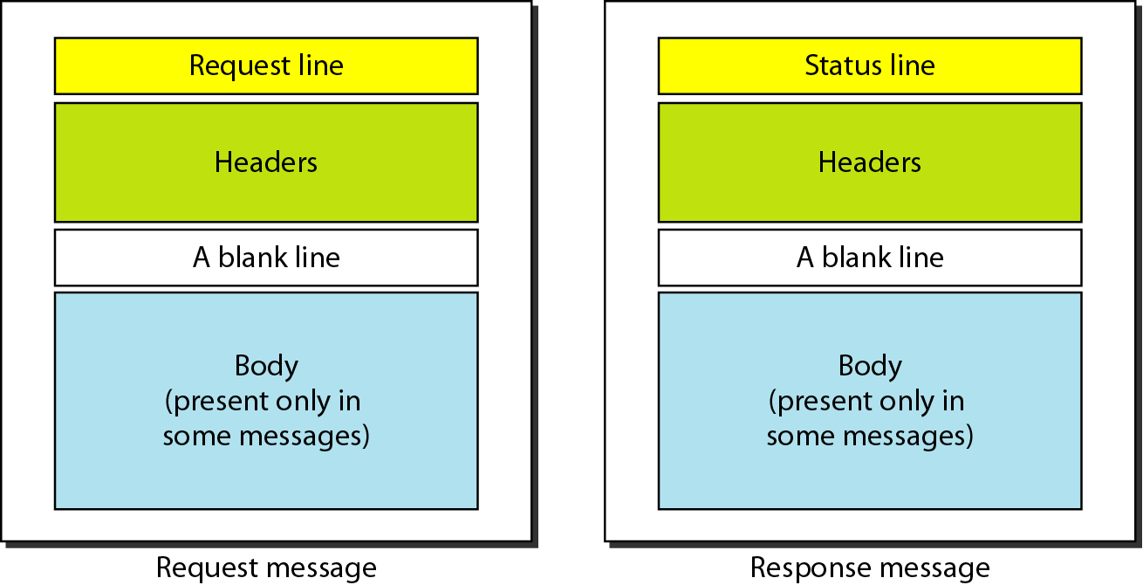

Slide 36
HTTP request message
two types of HTTP messages: request, response
HTTP request message:
ASCII (human-readable format)
carriage return character
request line
(GET, POST,
HEAD commands)
line-feed character
GET /index.html HTTP/1.1\r\n
Host: www-net.cs.umass.edu\r\n
User-Agent: Firefox/3.6.10\r\n
Accept: text/html,application/xhtml+xml\r\n
Accept-Language: en-us,en;q=0.5\r\n
Accept-Encoding: gzip,deflate\r\n
Accept-Charset: ISO-8859-1,utf-8;q=0.7\r\n
Keep-Alive: 115\r\n
Connection: keep-alive\r\n
\r\n
header
lines
carriage return,
line feed at start
of line indicates
end of header lines
* Check out the online interactive exercises for more examples: http://gaia.cs.umass.edu/kurose_ross/interactive/

Slide 37
HTTP request message: general format
method
sp
URL
sp
version
cr
lf
request
line
header field name
value
cr
lf
~
~
header
lines
~
~
header field name
value
cr
lf
cr
lf
~
entity body
~
body
~
~

Slide 38
HTTP response message
status line
(protocol
status code
status phrase)
HTTP/1.1 200 OK\r\n
Date: Sun, 26 Sep 2010 20:09:20 GMT\r\n
Server: Apache/2.0.52 (CentOS)\r\n
Last-Modified: Tue, 30 Oct 2007 17:00:02 GMT\r\n
ETag: "17dc6-a5c-bf716880"\r\n
Accept-Ranges: bytes\r\n
Content-Length: 2652\r\n
Keep-Alive: timeout=10, max=100\r\n
Connection: Keep-Alive\r\n
Content-Type: text/html; charset=ISO-8859-1\r\n
\r\n
data data data data data ...
header
lines
data, e.g.,
requested
HTML file
* Check out the online interactive exercises for more examples: http://gaia.cs.umass.edu/kurose_ross/interactive/

Slide 39
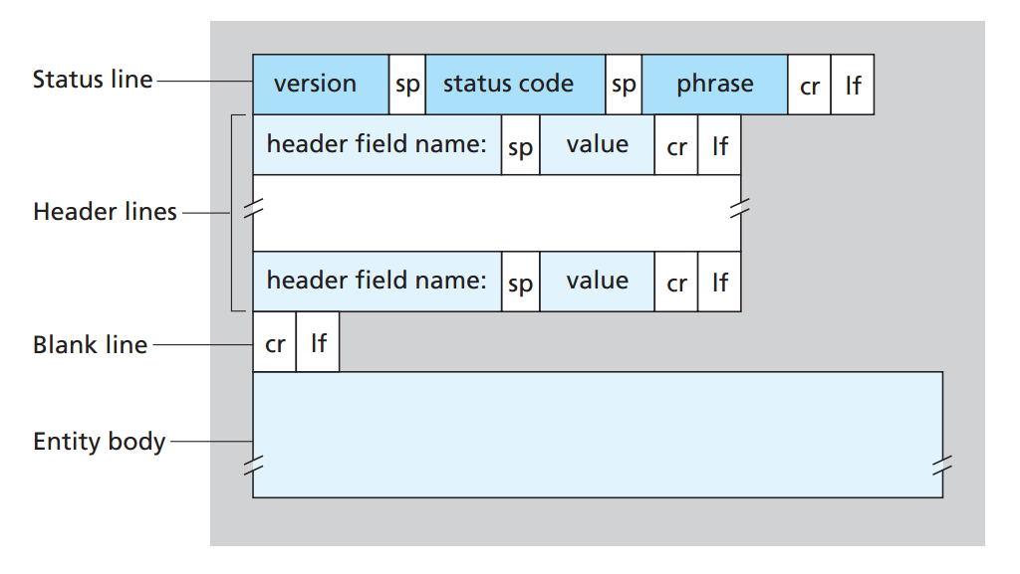

Slide 40
Status Codes
1xx | Informational
2xx | Success
3xx | Redirection
4xx | Client Error
5xx | Server Error

Slide 41
Response code

Slide 42
Start Lines
All HTTP messages begin with a start line. The start line for a request message says ‘what to do ’ . The start line for a response message says what happened.
GET /hello.htm HTTP/1.1 (This is Request-Line sent by the client)
HTTP/1.1 200 OK (This is Status-Line sent by the server)

Slide 43
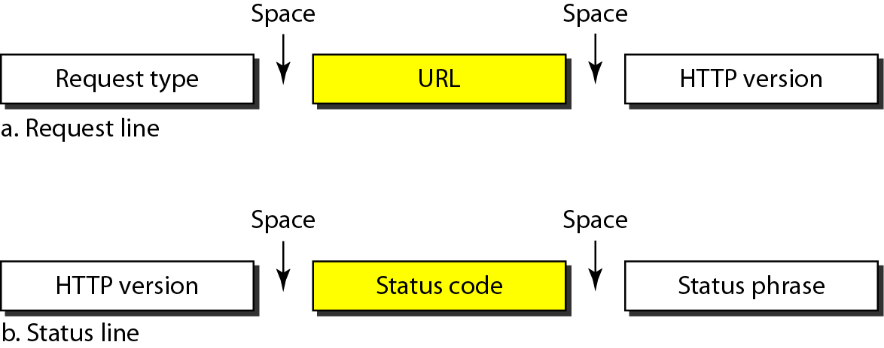

Slide 44
message-header = field-name ":" [ field-value ] HTTP message headers are used to precisely describe the resource being fetched or the behavior of the server or the client. There are four types of HTTP message headers: 1- General headers have general applicability for both request and response messages. 2-Request headers provide more information about the request. 3- Response headers provide more information about the request. 4-Entity headers define meta information about the entity-body or, if no body is present, about the resource identified by the request.
Headers

Slide 45
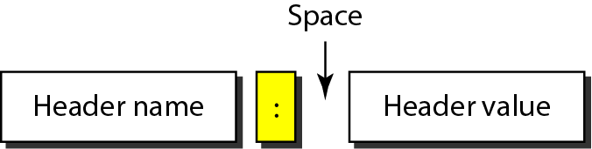
Header format

Slide 46
General headers

Slide 47
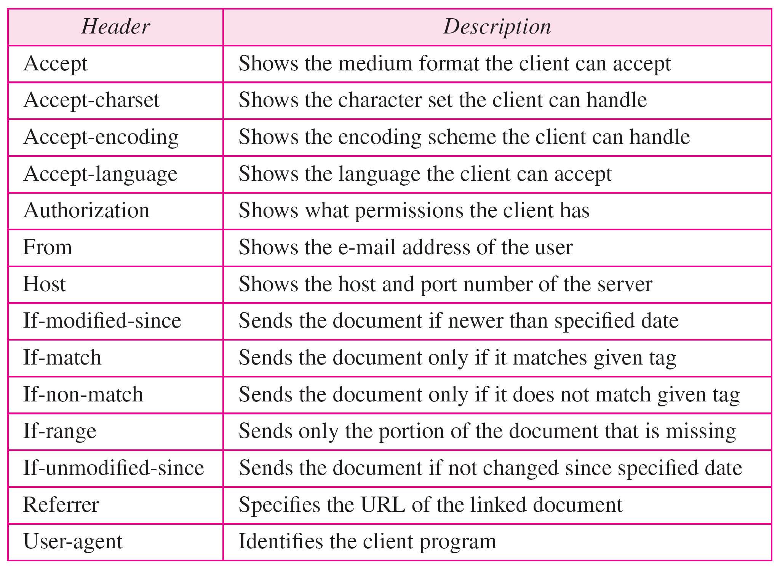
Request headers

Slide 48
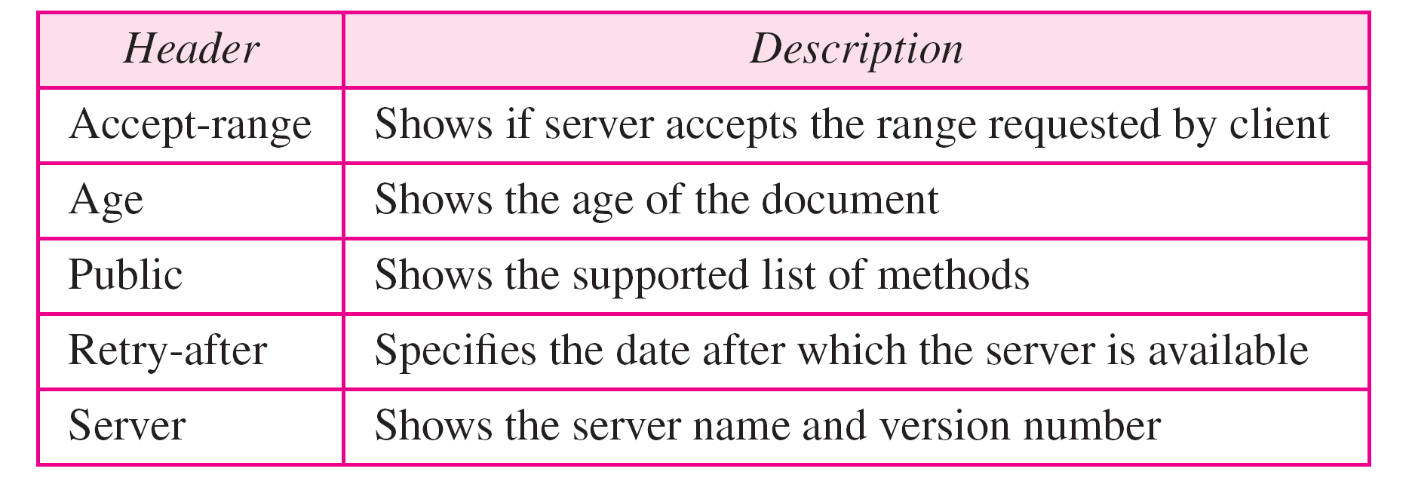
Response headers

Slide 49
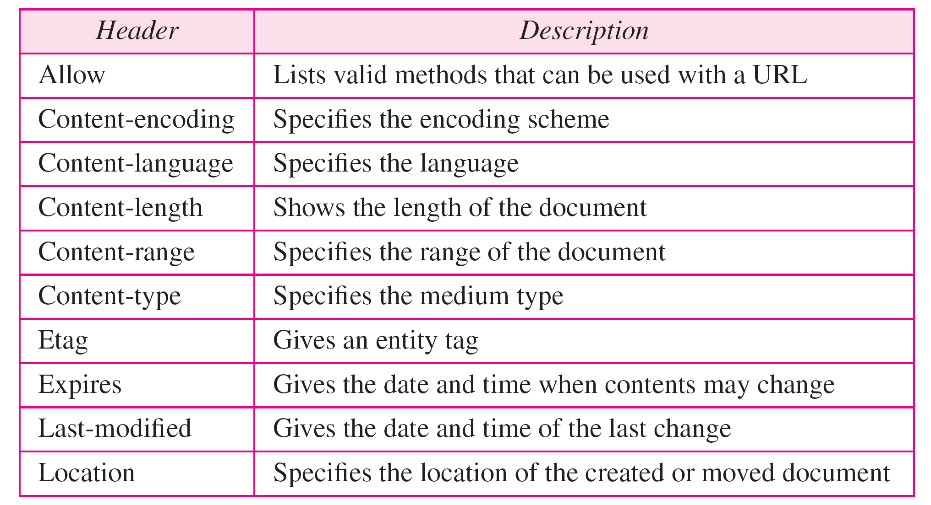
Entity headers

Slide 50
Body
The message-body (if any) of an HTTP message is used to carry the entity-body associated with the request or response. The message-body differs from the entity-body only when a transfer-coding has been applied, as indicated by the Transfer-Encoding header field

Slide 51
Let’s try some commands

Slide 52
"Tell me and I forget. Show me and I remember. Involve me and I understand." Chinese proverb

Slide 53
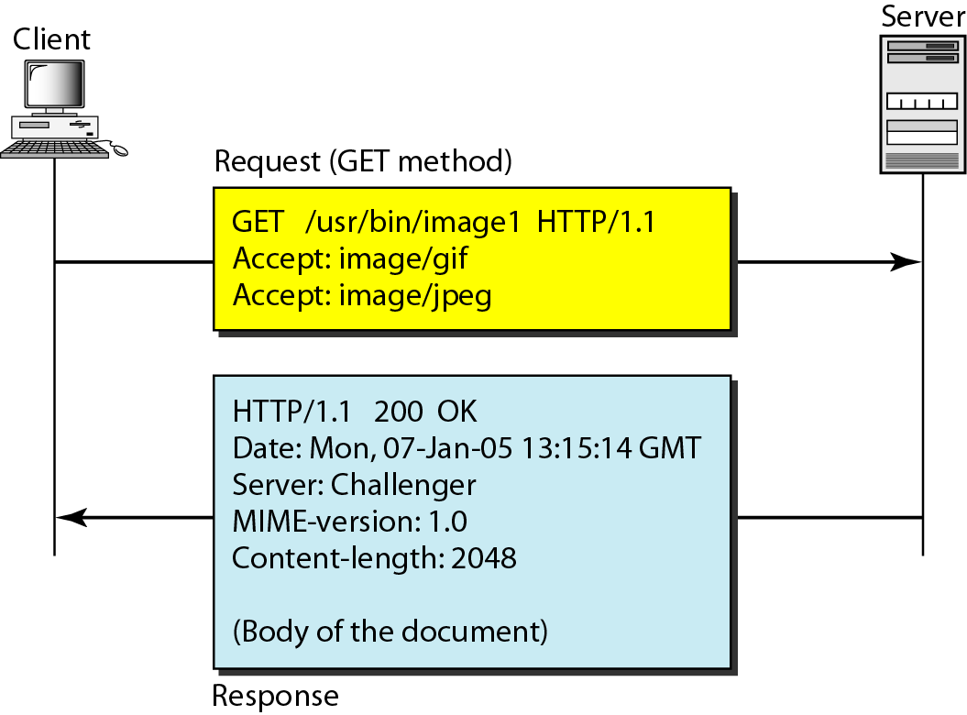
GET Example
Notes:
This example retrieves a document. We use the GET method to retrieve an image with the path /usr/bin/image1. The request line shows the method (GET), the URL, and the HTTP version (1.1). The header has two lines that show that the client can accept images in the GIF or JPEG format. The request does not have a body. The response message contains the status line and four lines of header. The header lines define the date, server, MIME version, and length of the document. The body of the document follows the header (see Figure 27.16).

Slide 54
This example retrieves a document. We use the GET method to retrieve an image with the path /usr/bin/image1. The request line shows the method (GET), the URL, and the HTTP version (1.1). The header has two lines that show that the client can accept images in the GIF or JPEG format. The request does not have a body. The response message contains the status line and four lines of header. The header lines define the date, server, MIME version, and length of the document. The body of the document follows the header (see Figure 27.16).

Slide 55
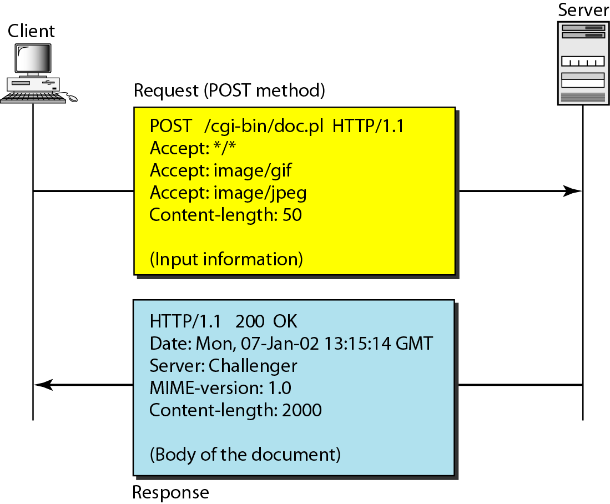
Post example
Notes:
HTTP uses ASCII characters. A client can directly connect to a server using TELNET, which logs into port 80. The next three lines show that the connection is successful. We then type three lines. The first shows the request line (GET method), the second is the header (defining the host), the third is a blank, terminating the request. The server response is seven lines starting with the status line. The blank line at the end terminates the server response. The file of 14,230 lines is received after the blank line (not shown here). The last line is the output by the client.

Slide 56
HTTP uses ASCII characters. A client can directly connect to a server using TELNET, which logs into port 80. The next three lines show that the connection is successful. We then type three lines. The first shows the request line (GET method), the second is the header (defining the host), the third is a blank, terminating the request. The server response is seven lines starting with the status line. The blank line at the end terminates the server response. The file of 14,230 lines is received after the blank line (not shown here). The last line is the output by the client.

Slide 57
What is Telnet
Telnet is a user command and an underlying TCP/IP protocol for accessing remote computers. Through Telnet, an administrator or another user can access someone else's computer remotely. On the Web, HTTP and FTP protocols allow you to request specific files from remote computers, but not to actually be logged on as a user of that computer. With Telnet, you log on as a regular user with whatever privileges you may have been granted to the specific application and data on that computer.

Slide 58
Let’s use Telnet

Slide 60
We can use the browser also
Notes:
telnet://rainmaker.wunderground.com

Slide 61
Other Example
rainmaker.wunderground.com :: weather via telnet!
nyancat.dakko.us :: art animation
telehack.com :: talk to Eliza

Slide 62
Latest version is http 2
The world with http 1.1 and http 2

Slide 63
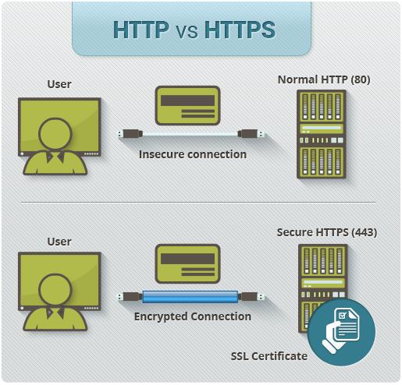
HTTPS
Difference from HTTP

Slide 64
1- HTTPS URLs begin with "https://" and use port 443 by default, whereas HTTP URLs begin with "http://" and use port 80 by default.
2- HTTP is not encrypted and is vulnerable to man-in-the-middle and eavesdropping attacks, which can let attackers gain access to website accounts and sensitive information, and modify webpages to inject malware or advertisements.
3- HTTPS is designed to withstand such attacks and is considered secure against them (with the exception of older, deprecated versions of SSL).

Slide 65
- Deploying HTTPS also allows the use of HTTP/2, that are new generations of HTTP, designed to reduce page load times and latency.
- Netscape Communications created HTTPS in 1994 for its Netscape Navigator web browser.Originally, HTTPS was used with the SSL protocol.
As of April 5th, 2016, 41.7% of the Internet's 141,160 most popular websites have a secure implementation of HTTPS.

Slide 66
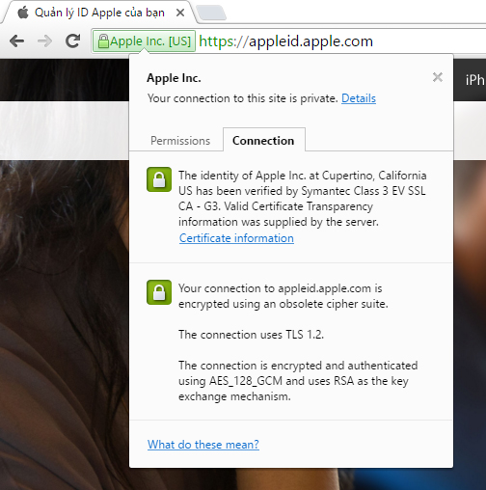
Working in HTTPS

Slide 67
Web browsers know how to trust HTTPS websites based on certificate authorities that come pre-installed in their software. Certificate authorities (such as Symantec(verisign), Comodo, Go Daddy and Global Sign) are in this way being trusted by web browser creators to provide valid certificates.

Slide 68
Everything in the HTTPS message is encrypted, including the headers, and the request/response load. The attacker can only know that a connection is taking place between the two parties and their domain names and IP addresses.

Slide 69
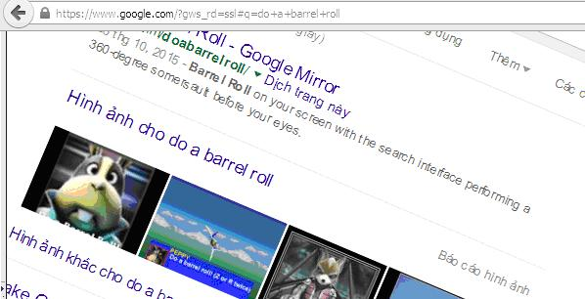
For example, Google’s search engine now defaults to HTTPS connections. This means that people can’t see what you’re searching for on Google.com

Slide 70
Architectural Components of the Web
In this overview chapter, we've focused on how two web applications (web browsers and web servers) send messages back and forth to implement basic transactions. There are many other web applications that you interact with on the Internet. In this section, we'll outline several other important applications, including:

Slide 71
Proxies : HTTP intermediaries that sit between clients and servers
Caches : HTTP storehouses that keep copies of popular web pages close to clients.
Gateways : Special web servers that connect to other applications .
Tunnels : Special proxies that blindly forward HTTP communications
Agents : Semi-intelligent web clients that make automated HTTP requests

Slide 72
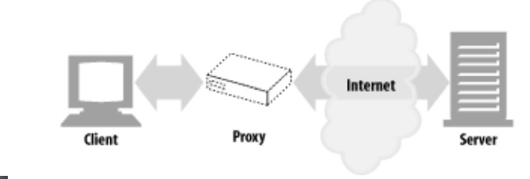
Proxies
Notes:
Let's start by looking at HTTP proxy servers,
important building blocks for web security, application integration, and performance optimization. As shown in Figure 1-11, a proxy sits between a client and a server, receiving all of the client's HTTP requests and relaying the requests to the server (perhaps after modifying the requests). These applications act as a proxy for the user, accessing the server on the user's behalf. Figure 1-11. Proxies relay traffic between client and server Proxies are often used for security, acting as trusted intermediaries through which all web traffic flows. Proxies can also filter requests and responses; for example, to detect application viruses in corporate downloads or to filter adult content away from elementary-school students.

Slide 73
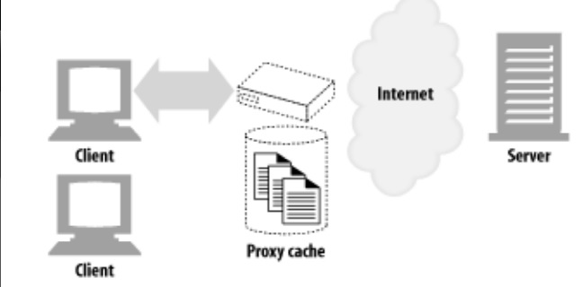
Caches
Notes:
A web cache or caching proxy is a special type of HTTP proxy server that keeps copies of popular documents that pass through the proxy. The next client requesting the same document can be served from the cache's personal copy
A client may be able to download a document much more quickly from a nearby cache than from a distant web server. HTTP defines many facilities to make caching more effective and to regulate the freshness and privacy of cached content.

Slide 74
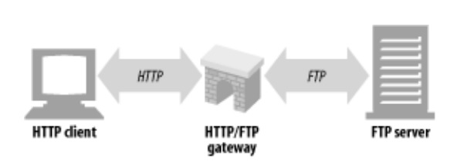
Gateways
Notes:
Gateways are special servers that act as intermediaries for other servers. They are often used to convert HTTP traffic to another protocol. A gateway always receives requests as if it was the origin server for the resource. The client may not be aware it is communicating with a gateway. For example, an HTTP/FTP gateway receives requests for FTP URIs via HTTP requests but fetches the documents using the FTP protocol ( look the figure ) The resulting document is packed into an HTTP message and sent to the client.

Slide 75
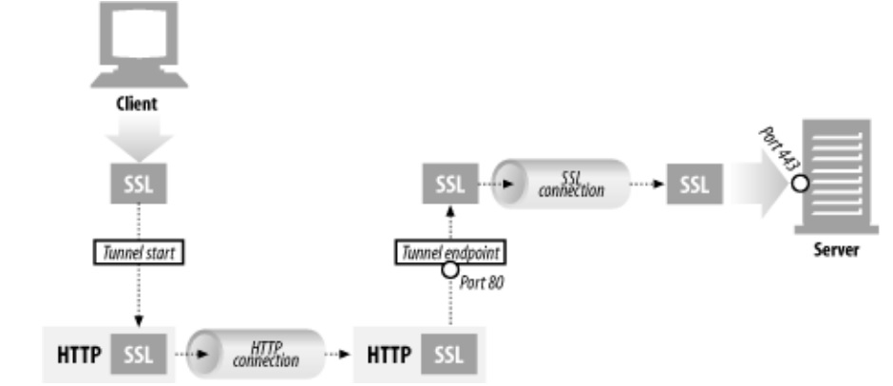
Tunnels
Notes:
Tunnels are HTTP applications that, after setup, blindly relay raw data between two connections. HTTP tunnels are often used to transport non-HTTP data over one or more HTTP connections, without looking at the data. One popular use of HTTP tunnels is to carry encrypted Secure Sockets Layer (SSL) traffic through an HTTP connection, allowing SSL traffic through corporate firewalls that permit only web traffic. As sketched in Figure 1-14, an HTTP/SSL tunnel receives an HTTP request to establish an outgoing connection to a destination address and port, then proceeds to tunnel the encrypted SSL traffic over the HTTP channel so that it can be blindly relayed to the destination server.

Slide 76
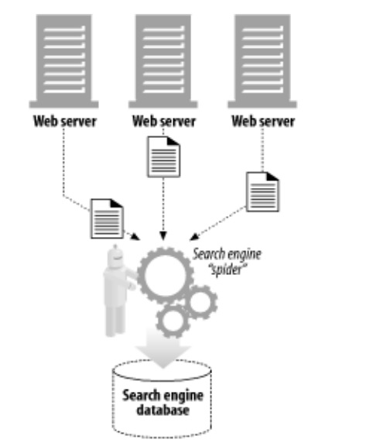
Agents
Notes:
User agents (or just agents) are client programs that make HTTP requests on the user's behalf. Any application that issues web requests is an HTTP agent. So far, we've talked about only one kind of HTTP agent: web browsers. But there are many other kinds of user agents. For example, there are machine-automated user agents that autonomously wander the Web, issuing HTTP transactions and fetching content, without human supervision. These automated agents often have colorful names, such as "spiders" or "web robots" (see Figure 1-15). Spiders wander the Web to build useful archives of web content, such as a search engine's database or a product catalog for a comparison-shopping robot

Slide 77
The End of the Beginning
That's it for our quick introduction to HTTP. In this chapter, we highlighted HTTP's role as a multimedia transport protocol. We outlined how HTTP uses URIs to name multimedia resources on remote servers, we sketched how HTTP request and response messages are used to manipulate multimedia resources on remote servers, and we finished by surveying a few of the web applications that use HTTP.

